Slide 1


22년 삼성 AI 전문가과정
6월 7일 화요일 2교시
장병탁
인공지능
2차시 : Intelligent Agents
서울대학교 컴퓨터공학부
담당 교수: 장병탁
Seoul National University
Byoung-Tak Zhang

Slide 2
Lecture Overview
인공지능
2차시 : Intelligent Agents
서울대학교 컴퓨터공학부
담당 교수: 장병탁
Seoul National University
Byoung-Tak Zhang

Slide 3
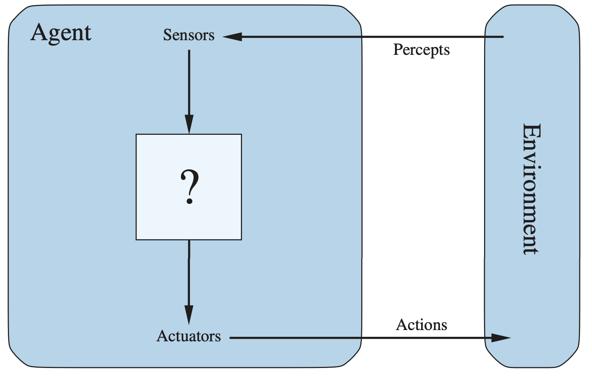
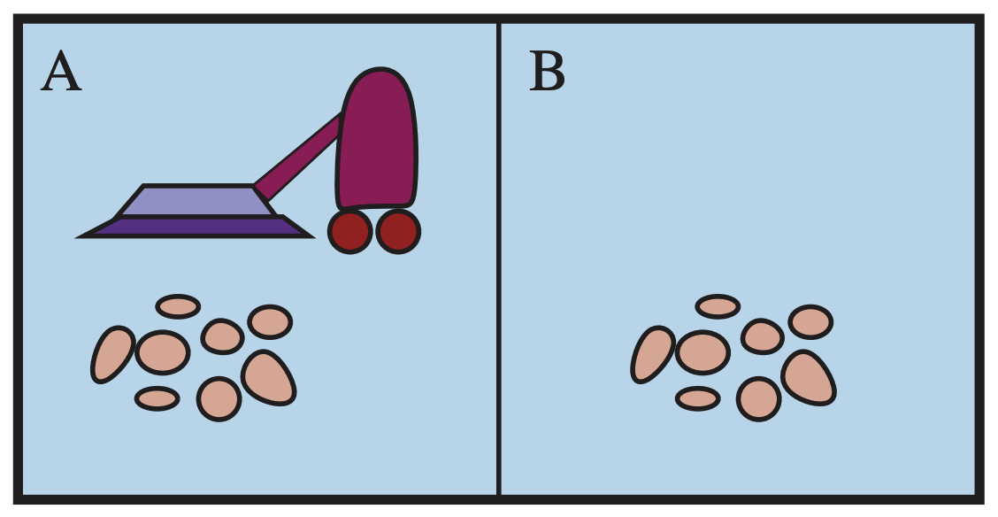
Lecture 2. Intelligent Agents
Artificial intelligence as building intelligent agents
Agents and Environments
The concept of agent with environment
Examples of agents: humans, robots etc.
Good Behavior: Rationality
The concept of rationality
The Nature of Environments
PEAS: Performance, Environment, Actuators, Sensors
The Structure of Agents
Simple reflex agents, Model-based reflex agents Goal-based agents, Utility-based agents, Learning agents
<출처> Stuart J. Russell and Peter Norvig(2021). Artificial Intelligence: A Modern Approach (4th Edition). Pearson

Slide 4
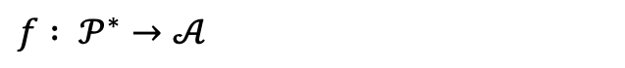
Intelligent Agents
Artificial Intelligence as Building Intelligent Agents
Agent
An agent is anything that can be viewed as perceiving its environment through sensors and acting upon that environment through actuators
Agents include humans, robots, softbots, thermostats, etc.
The agent function maps from percept histories to actions:
<출처> Stuart J. Russell and Peter Norvig (2021). Artificial Intelligence: A Modern Approach (4th Edition). Pearson

Slide 5
Vacuum Cleaner as an Intelligent Agent
Intelligence = rationality. AI as building a rational agent: A rational agent chooses whichever action maximizes the expected value of the performance measure given the percept sequence to date.
Agent’s Environment:
To design a rational agent, we must specify the task environment
PEAS
Performance
Environment
Actuators
Sensors
<출처> Stuart J. Russell and Peter Norvig (2021). Artificial Intelligence: A Modern Approach (4th Edition). Pearson

Slide 6
Lecture 2. Intelligent Agents
Artificial intelligence as building intelligent agents
Agents and Environments
The concept of agent with environment
Examples of agents: humans, robots etc.
Good Behavior: Rationality
The concept of rationality
The Nature of Environments
PEAS: Performance, Environment, Actuators, Sensors
The Structure of Agents
Simple reflex agents, Model-based reflex agents Goal-based agents, Utility-based agents, Learning agents
<출처> Stuart J. Russell and Peter Norvig(2021). Artificial Intelligence: A Modern Approach (4th Edition). Pearson

Slide 7
Outline (Lecture 2)
2.1 Agents and Environments
2.2 Good Behavior: Rationality
2.3 The Nature of Environments
2.4 The Structure of Agents
Summary
8
11
13
19
28

Slide 8
2.1. Agents and Environments

Slide 9
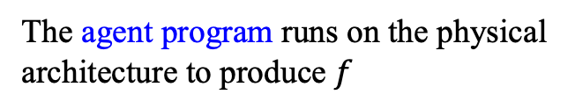
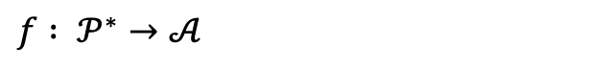
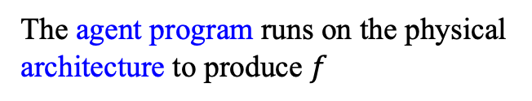
2.1 Agents and Environments (1/2)
1) Agent
An agent is anything that can be viewed as perceiving its environment through sensors and acting upon that environment through actuators
Agents include humans, robots, softbots, thermostats, etc.
The agent function maps from percept histories to actions:
The agent program runs on the physical architecture to produce $f$
<출처> Stuart J. Russell and Peter Norvig (2021). Artificial Intelligence: A Modern Approach (4th Edition). Pearson

Slide 10
2.1 Agents and Environments (2/2)
2) Example: vacuum-cleaner world
Partial tabulation of a simple agent function
A vacuum-cleaner world
with just two locations
Percept sequence | Action
[A, clean] [A, dirty] [B, clean] [B, dirty] [A, clean], [A, clean] [A, clean], [A, dirty] … [A, clean], [A, clean], [A, clean] [A, clean], [A, clean], [A, dirty] … | Right Suck Left Suck Right Suck … Right Suck …
<출처> Stuart J. Russell and Peter Norvig (2021). Artificial Intelligence: A Modern Approach (4th Edition). Pearson

Slide 11
2.2. Good Behavior: Rationality

Slide 12
2.2 Good Behavior: Rationality
The concept of rationality
A rational agent chooses whichever action maximizes the expected value of the performance measure given the percept sequence to date
Rationality does not require omniscience
An omniscient agent knows the actual outcome of its actions and can act accordingly.
Rational choice depends only on the percept sequence to date
A rational agent should be able to explore
Doing actions in order to modify future percepts (i.e. information gathering) is an important part of rationality. Exploration.
A rational agent should learn as much as possible from what it perceives
A rational agent should be autonomous
It should learn what it can to compensate for partial or incorrect prior knowledge

Slide 13
2.3. The Nature of Environments

Slide 14
2.3 The Nature of Environments (1/5)
1) PEAS
To design a rational agent, we must specify the task environment
Performance
Environment
Actuators
Sensors
<출처> Stuart J. Russell and Peter Norvig (2021). Artificial Intelligence: A Modern Approach (4th Edition). Pearson

Slide 15
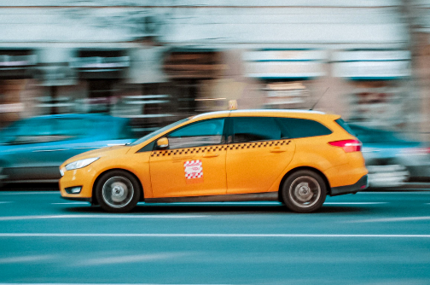

2.3 The Nature of Environments (2/5)
PEAS of automated taxi
Performance
Safety, destination, profits, legality, comfort, …
Environment
US streets/freeways, traffic, pedestrians,
Actuators
Steering, accelerator, brake, horn, speaker/display, …
Sensors
Video, accelerometers, gauges, engine sensors, keyboard, GPS, …

Slide 16


2.3 The Nature of Environments (3/5)
PEAS of internet shopping agent
Performance
Price, quality, appropriateness, efficiency
Environment
Current and future WWW sites, vendors, shippers
Actuators
Display to user, follow URL, fill in form
Sensors
HTML pages (text, graphics, scripts)

Slide 17
2.3 The Nature of Environments (4/5)
2) Properties of task environments
Fully Observable vs. Partially Observable
Deterministic vs. Stochastic
Episodic vs. Sequential
Static vs. Dynamic
Discrete vs. Continuous
Single-agent vs. Multi-agent
<출처> Stuart J. Russell and Peter Norvig (2021). Artificial Intelligence: A Modern Approach (4th Edition). Pearson

Slide 18
2.3 The Nature of Environments (5/5)
3) Examples of environment types
 | Solitaire | Backgammon | Internet Shopping | Taxi
Observable? | Yes | Yes | No | No
Deterministic? | Yes | No | Partly | No
Episodic? | No | No | No | No
Static? | Yes | Semi | Semi | No
Discrete? | Yes | Yes | Yes | No
Single-agent? | Yes | No | Yes (except auctions) | No
The environment type largely determines the agent design

Slide 19
2.4. The Structure of Agents

Slide 20
2.4 The Structure of Agents (1/8)
Agent types
Four basic types in order of increasing generality
Simple reflex agents
Model-based reflex agents
Goal-based agents
Utility-based agents
All these can be turned into learning agents

Slide 21
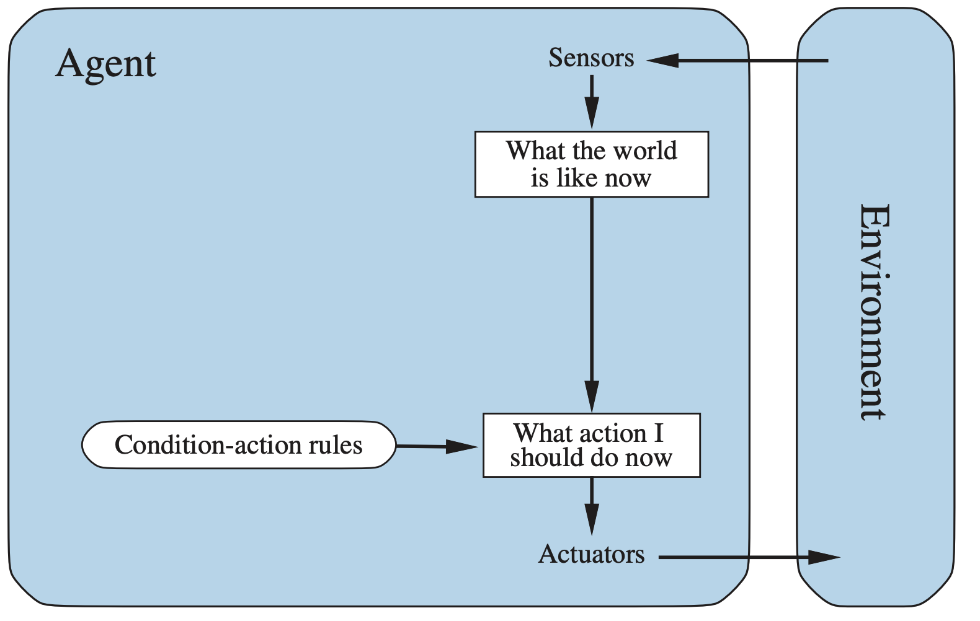
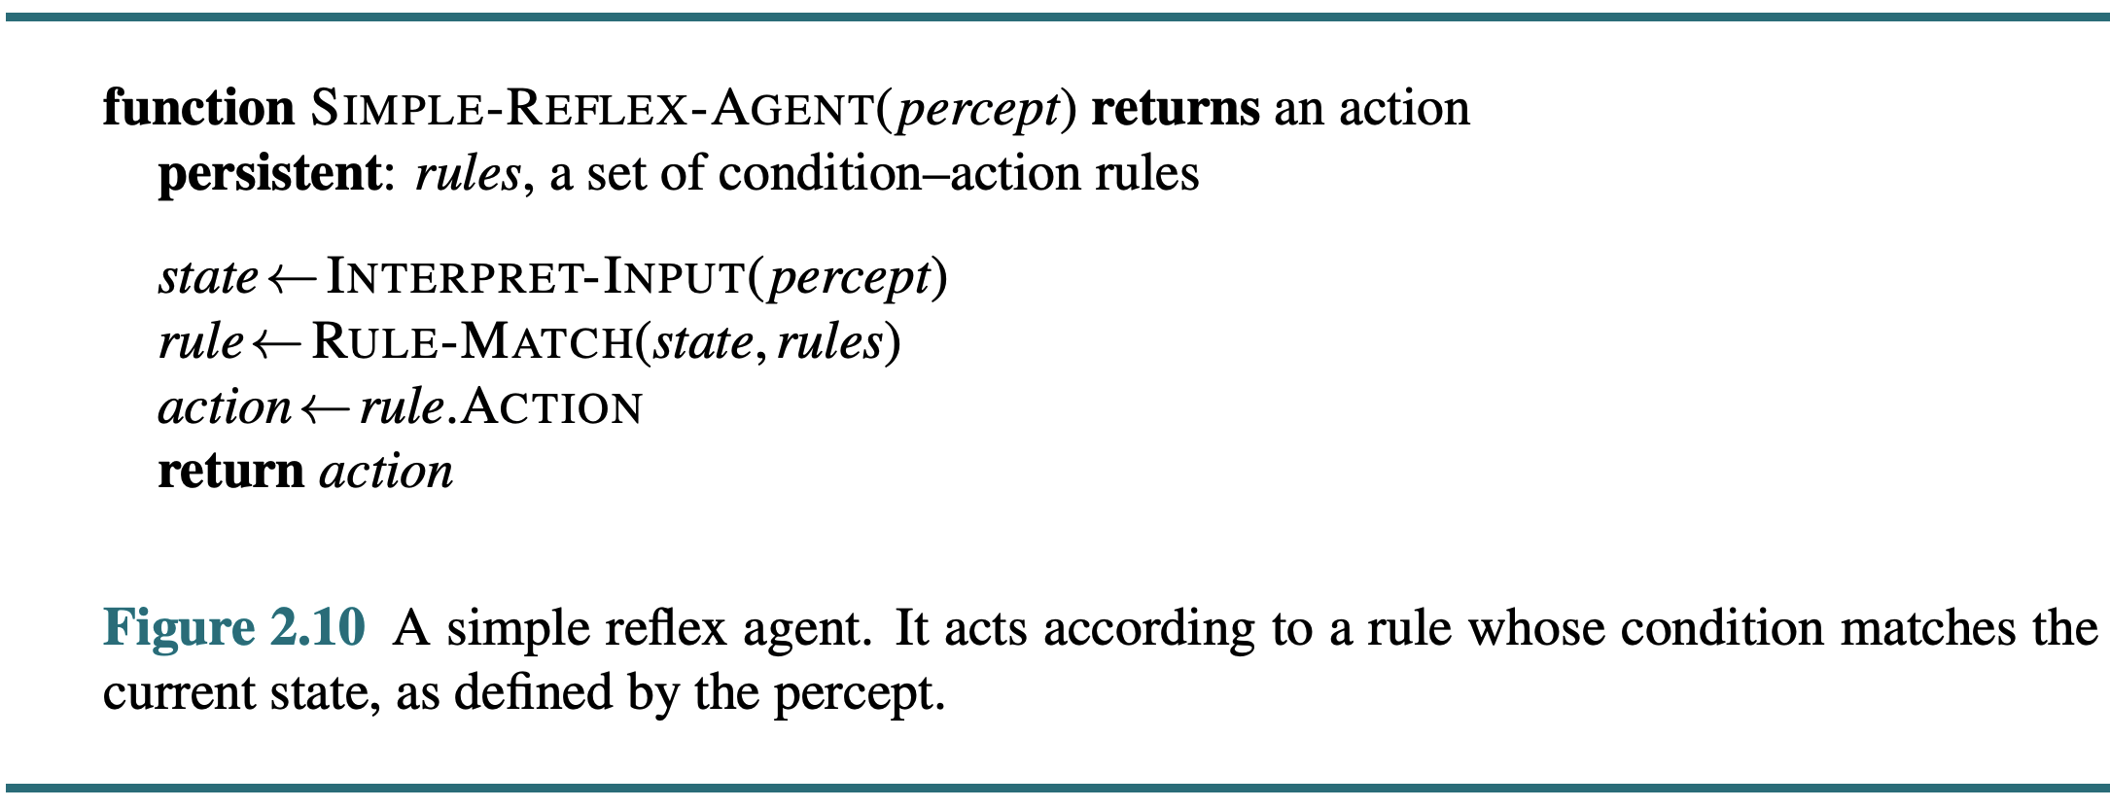
2.4 The Structure of Agents (2/8)
1) Simple reflex agents
<출처> Stuart J. Russell and Peter Norvig (2021). Artificial Intelligence: A Modern Approach (4th Edition). Pearson

Slide 22
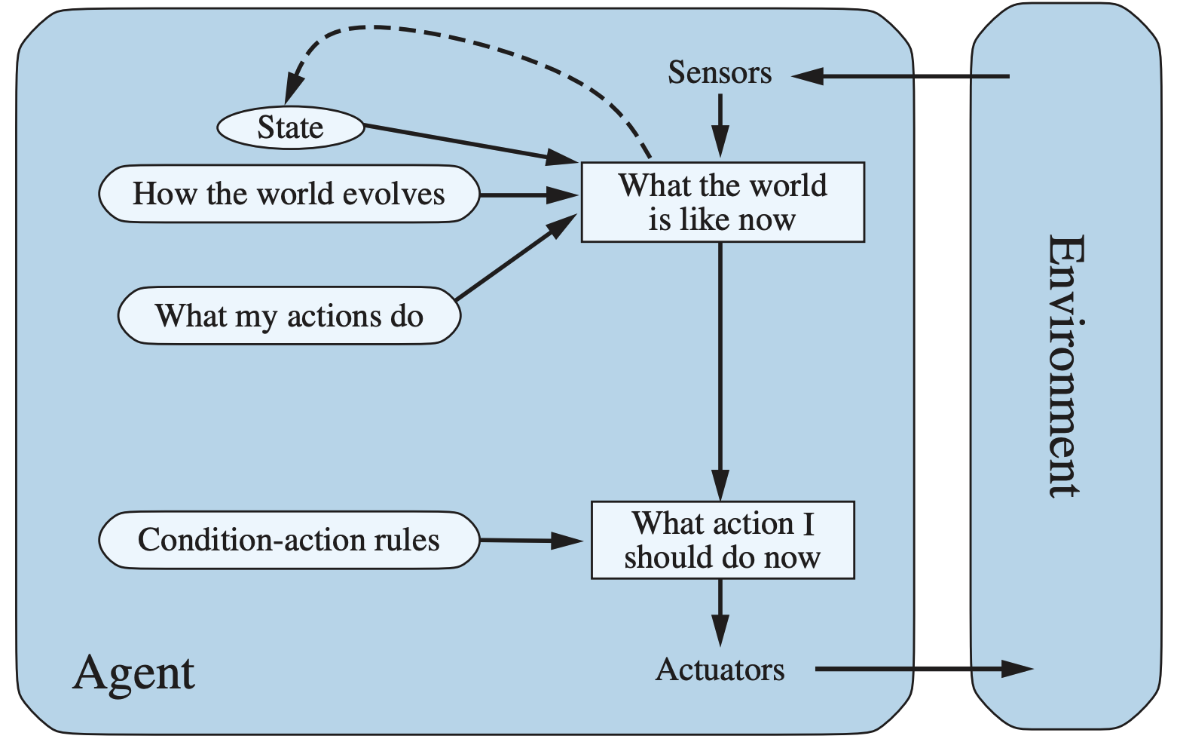
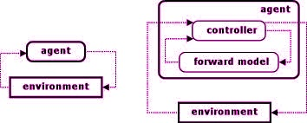
2.4 The Structure of Agents (3/8)
2) Model-based reflex agents
p
a
p
a
s
<출처> Stuart J. Russell and Peter Norvig (2021). Artificial Intelligence: A Modern Approach (4th Edition). Pearson

Slide 23
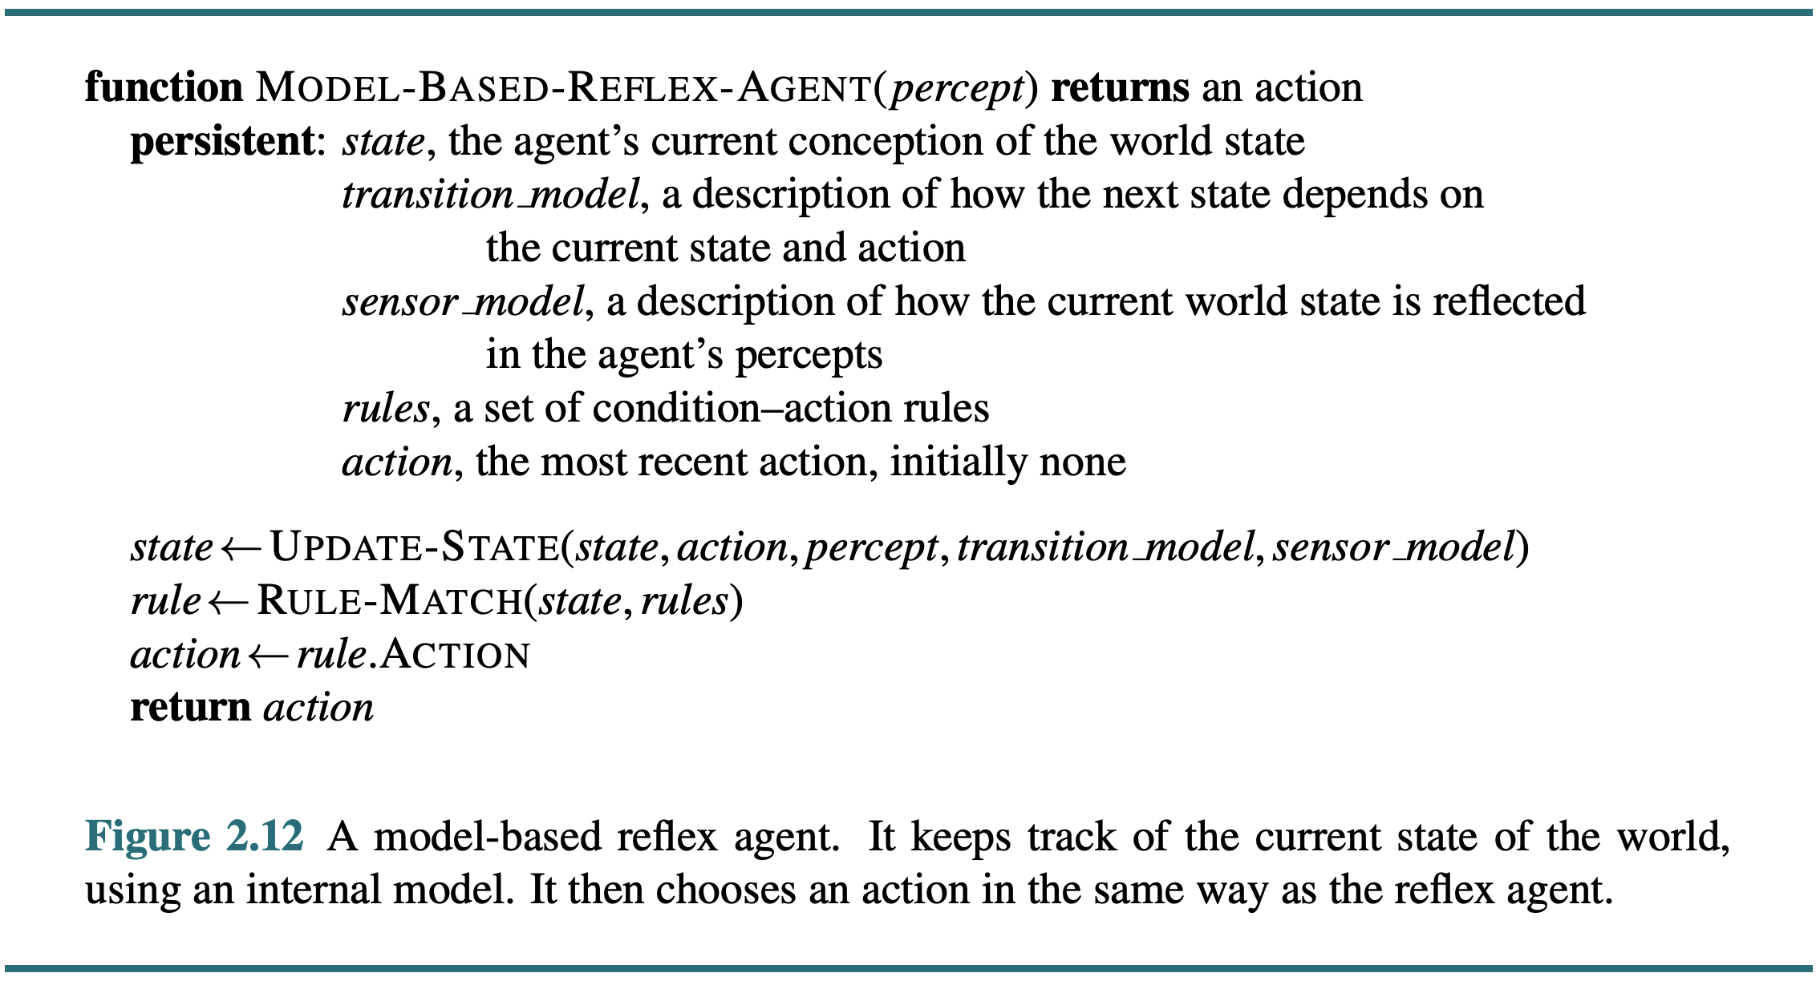
2.4 The Structure of Agents (4/8)
p
a
p
a
s
<출처> Stuart J. Russell and Peter Norvig (2021). Artificial Intelligence: A Modern Approach (4th Edition). Pearson

Slide 24
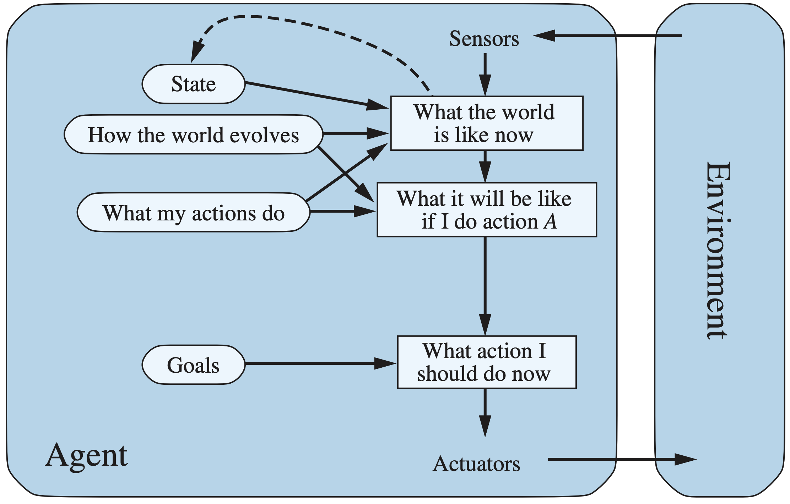
2.4 The Structure of Agents (5/8)
3) Goal-based agents
<출처> Stuart J. Russell and Peter Norvig (2021). Artificial Intelligence: A Modern Approach (4th Edition). Pearson

Slide 25
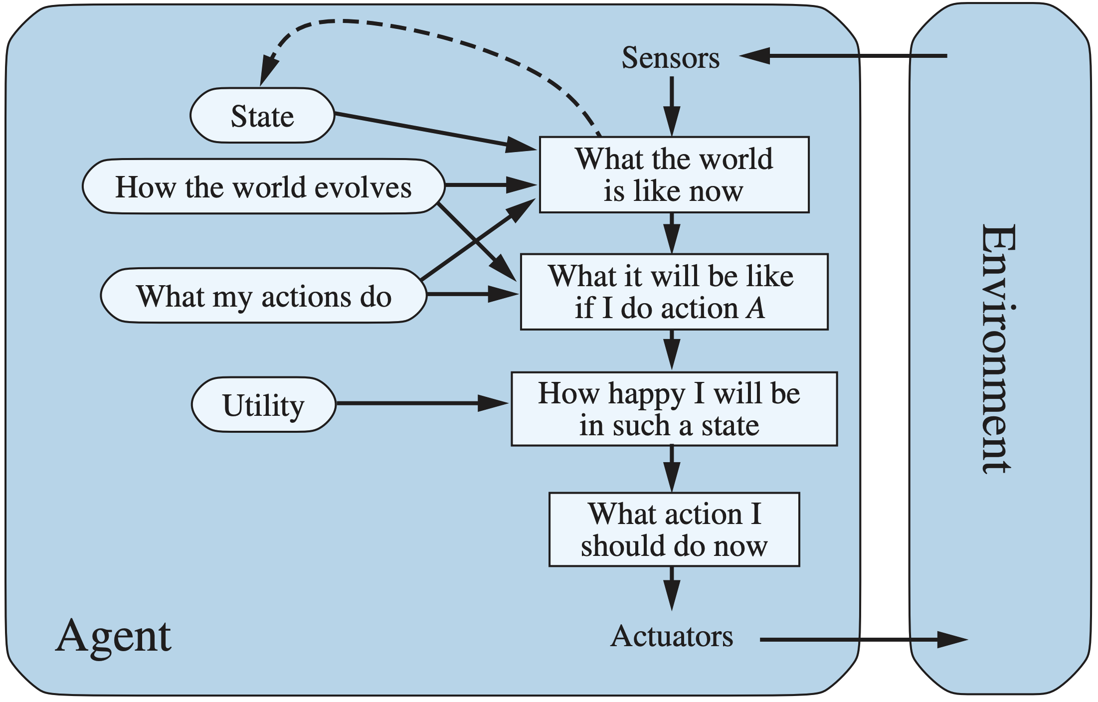
2.4 The Structure of Agents (6/8)
4) Utility-based agents
<출처> Stuart J. Russell and Peter Norvig (2021). Artificial Intelligence: A Modern Approach (4th Edition). Pearson

Slide 26
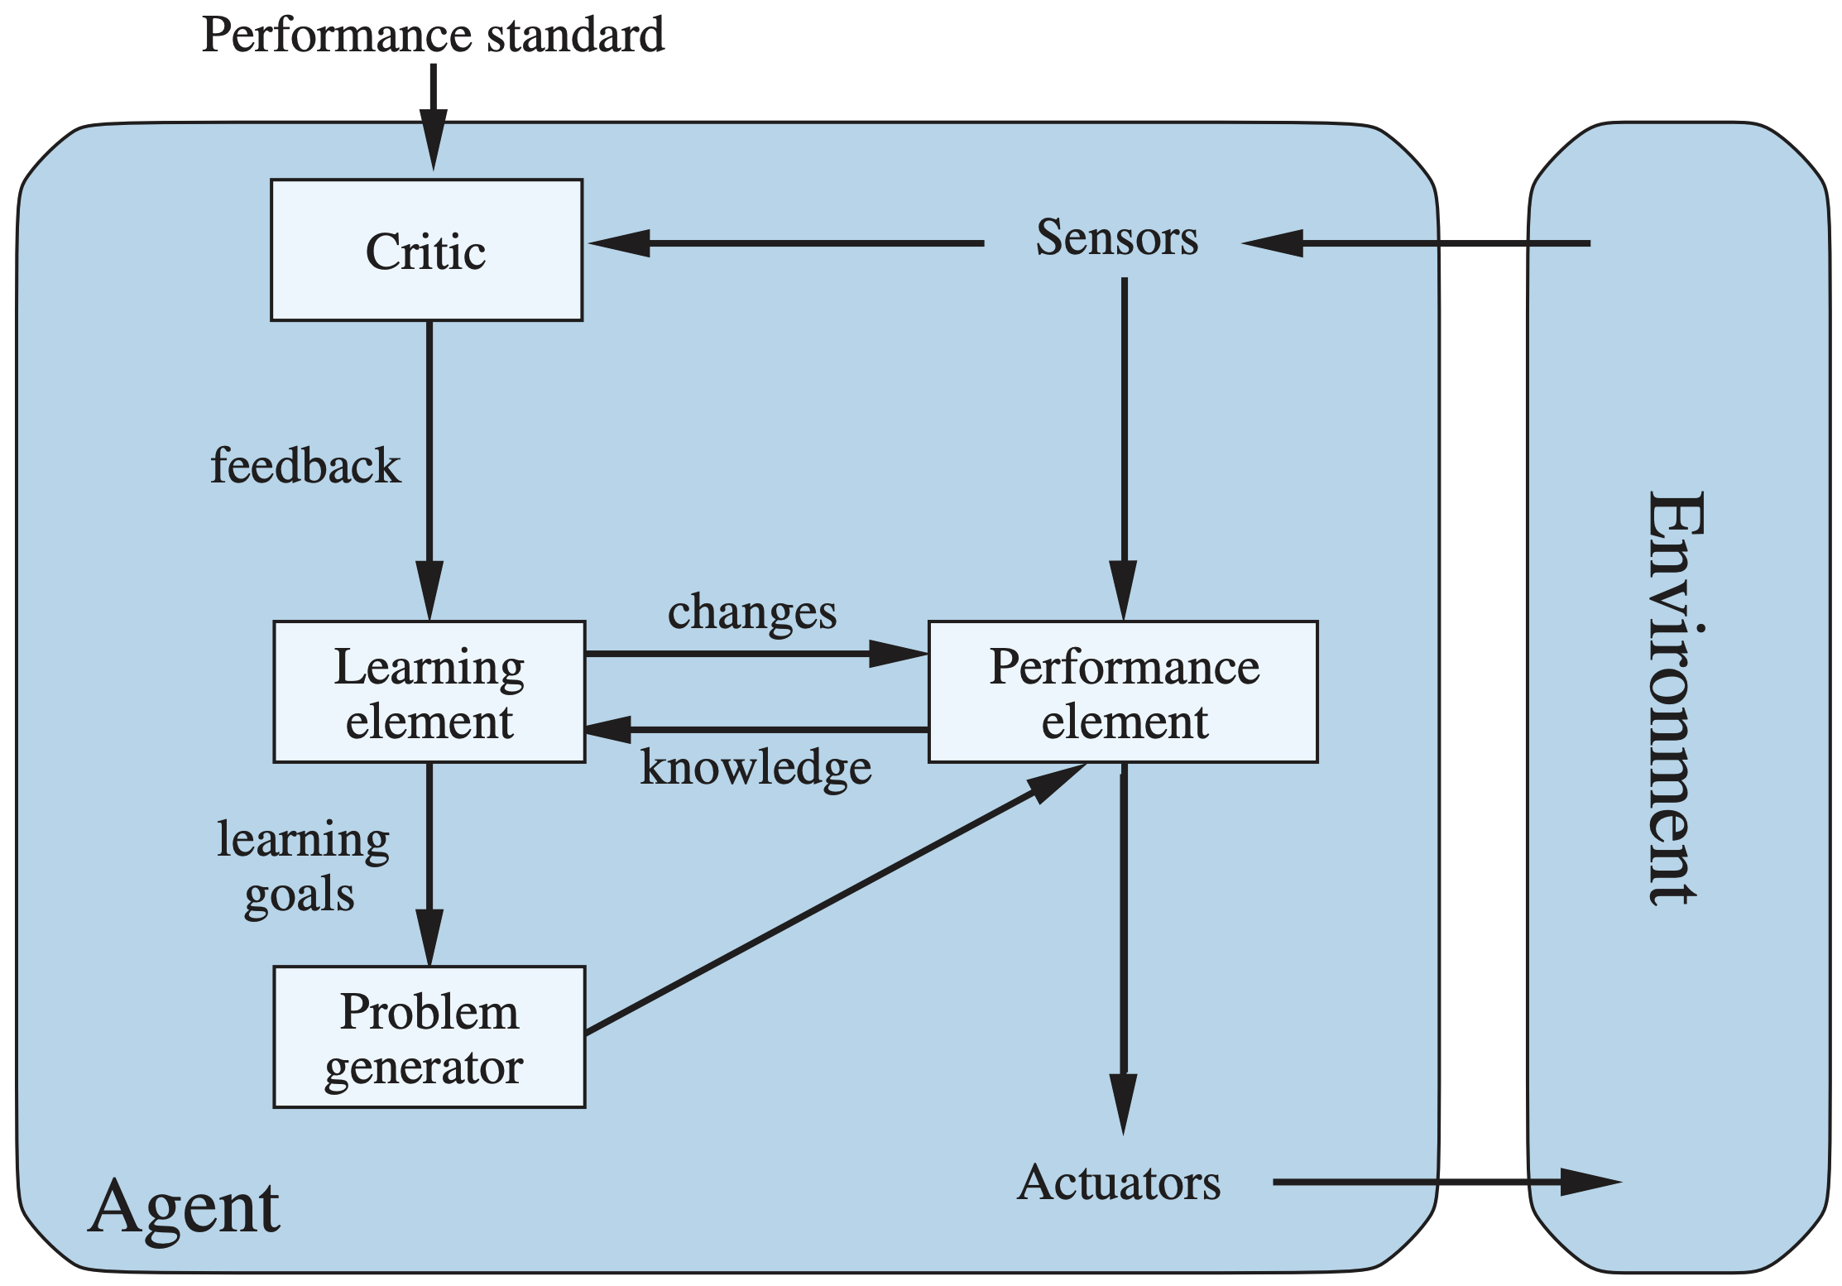
2.4 The Structure of Agents (7/8)
5) Learning agents
<출처> Stuart J. Russell and Peter Norvig (2021). Artificial Intelligence: A Modern Approach (4th Edition). Pearson

Slide 27
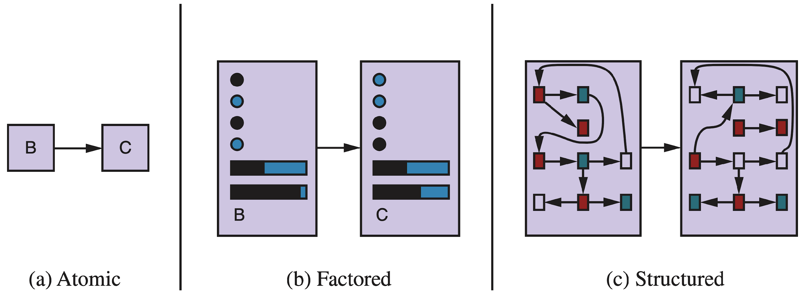
2.4 The Structure of Agents (8/8)
Three ways to represent states and transitions
<출처> Stuart J. Russell and Peter Norvig (2021). Artificial Intelligence: A Modern Approach (4th Edition). Pearson

Slide 28
Summary
Agents interact with environments through actuators and sensors
The agent function describes what the agent does in all circumstances
The performance measure evaluates the environment sequence
A perfectly rational agent maximizes expected performance
Agent programs implement (some) agent functions
PEAS descriptions define task environments
Environments are categorized along several dimensions:
Observable? deterministic? episodic? static? discrete? single-agent?
Several basic agent architectures exist:
Reflex, model-based, goal-based, utility-based, learning agents

